Slide 1
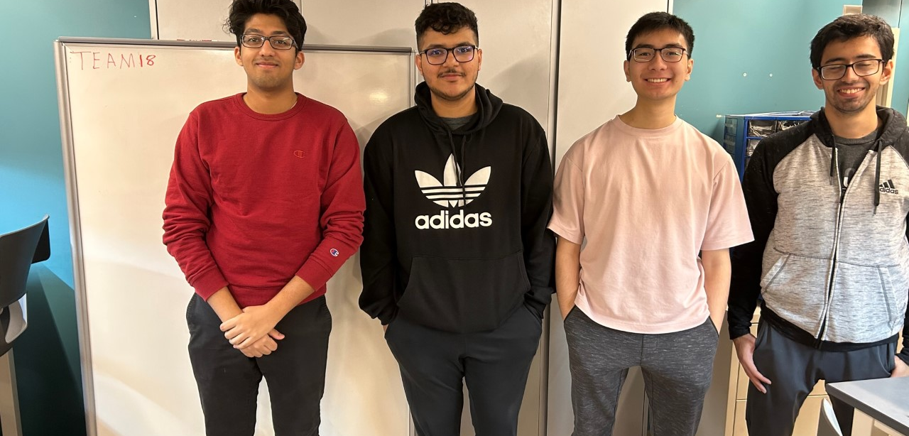

ECE477 MIDTERM DESIGN REVIEW: TEAM #18

Slide 2
OUTLINE
Project Overview
PSSCs
Block Diagram
Major Components
Prototyping Progress
Electrical Schematic
PCB Layout
Software Development Status
Packaging Design
Project Timeline
Questions
Notes:
anu

Slide 3
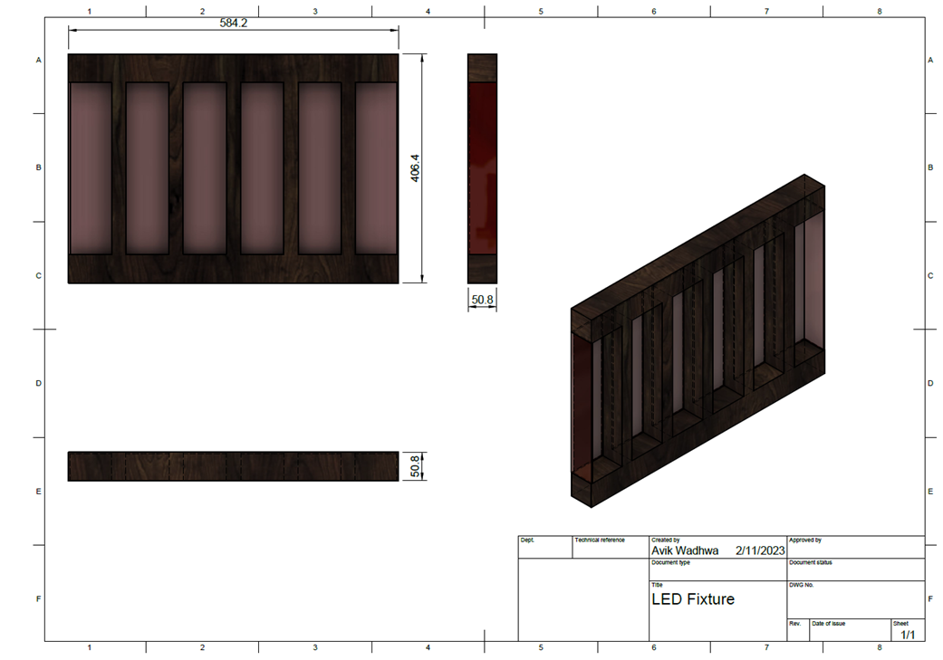
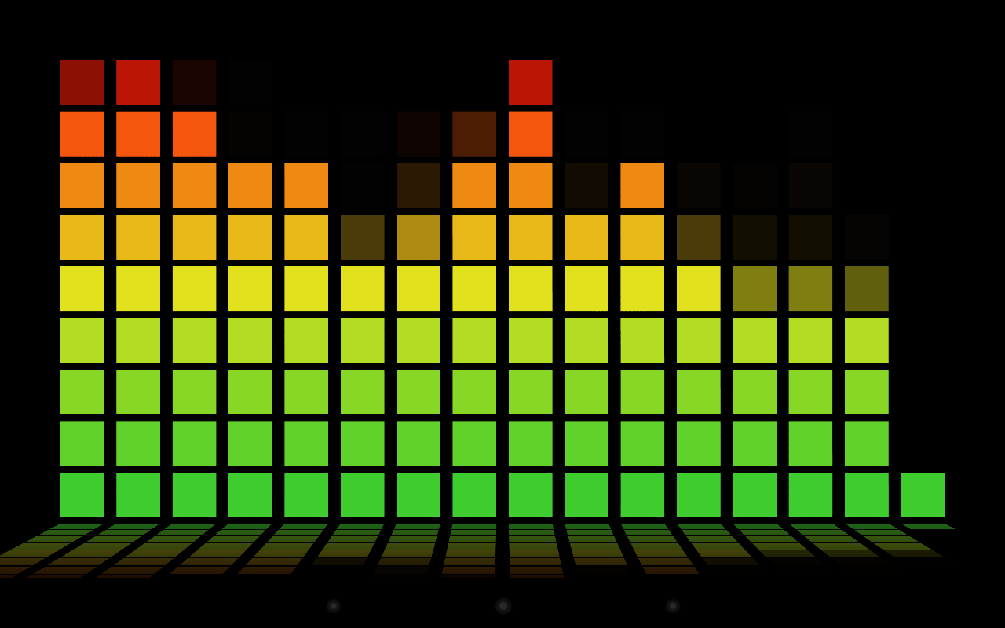
PROJECT OVERVIEW
Audio visualizer that lights up an LED display to correspond with input audio
Real time analysis of input audio
Easily configure patterns and colors through associated Android app
Multiple audio input modes: Microphone, AUX, Bluetooth
Notes:
anu

Slide 4
PSSCS
PSSC #1 (Software): The ability to reduce noise on analog inputs through the use of a 1-D Gaussian Filtering algorithm.
PSSC #2 (Software): The ability to control and configure multiple connected LED devices through a in-built bluetooth module that connects with Android app through UART.
PSSC #3 (Hardware): The ability to amplify and filter analog input of the microphone using a sequence of operational amplifiers.
PSSC #4 (Hardware): The ability for the user to toggle between input modes through multiplexed external controls. These modes will be Microphone (default), AUX-in, and Bluetooth audio.
PSSC #5 (Hardware): The ability to drive multiple WS2812B LED strips with PWM signals and reactively display patterns in response to audio signals.
Stretch Goal #1: The ability to isolate frequencies using the FFT algorithm.
Stretch Goal #2: The ability to regulate power down from 5V DC to 3.3V DC with a switching regulator.
Notes:
anu

Slide 5
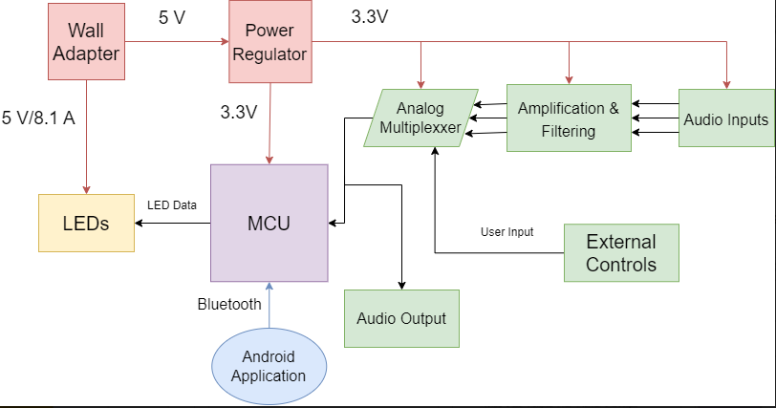
BLOCK DIAGRAM
Notes:
kahaan

Slide 6
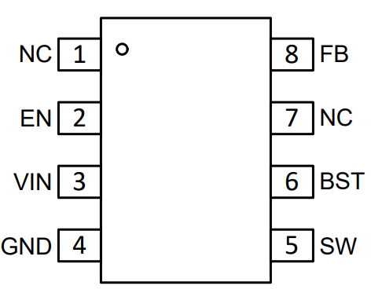
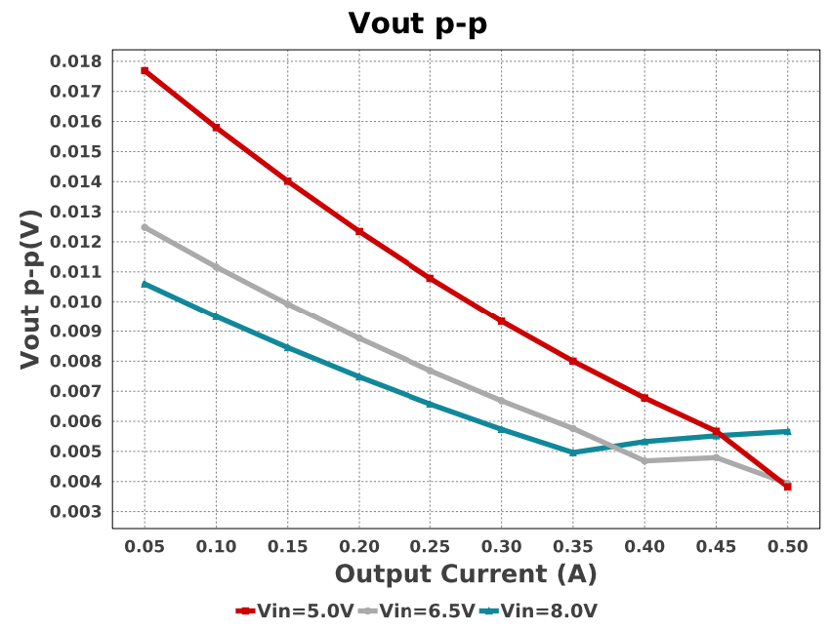
Component Selection: Synchronous Buck Converter
TPS56330
3.8V to 28V input voltage range
0.8V to 22V output voltage range
3-A continuous output current
Voltage Input | 3.8V-28V
Voltage Output | 0.8V-22V
Current Output | 0A-3A
Recommended Characteristics
Notes:
kahaan

Slide 7
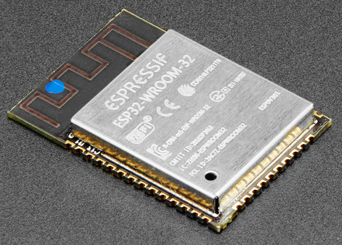
Component Selection: Microcontroller
ESP32-WROOM32
Selection Rationale:
High Clock Speed: 80-240MHz
Wi-Fi and Bluetooth capabilities
Dual-Core CPU
520KB of RAM
4MB of Flash Memory
12-bit internal ADC peripheral
Familiarity
Cost effective
Notes:
kahaan

Slide 8
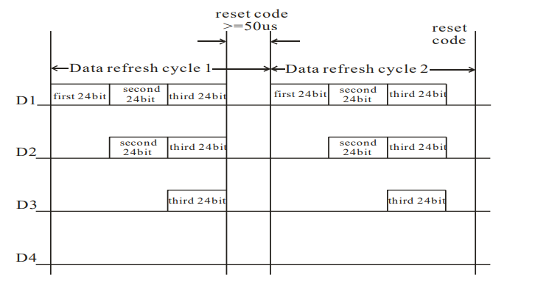
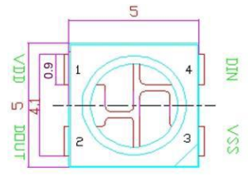
Component Selection: LEDs
WS2812B
Selection Rationale:
3-pin channels allow for individual addressability
Previous generation of LEDs (WS2811) only had separate channels for RGB
Send data speed of 800 Kbps
Scan frequency 400Hz
Notes:
kahaan

Slide 9
Prototyping Progress
Component | Status
Microphone Audio Filtering | 60%
Aux Input/Output | 80%
Power Circuit | 0%
Audio Multiplexer | 0%
The remaining progress in each of this component is primarily focused on software development:
Audio filter through Gaussian Filtering algorithm
AUX input output routing through Analog Multiplexer to AUX
Audio input sampling, FFT, and visual pattern generation combined system
Notes:
graeme

Slide 10
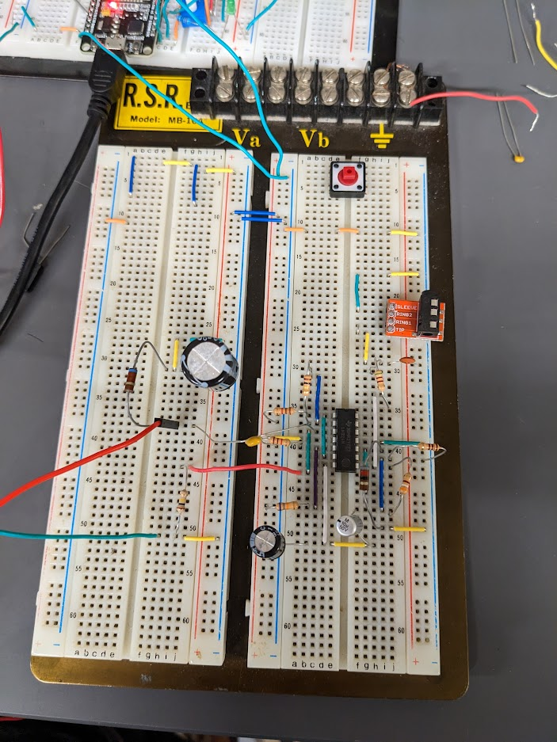
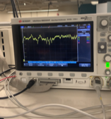
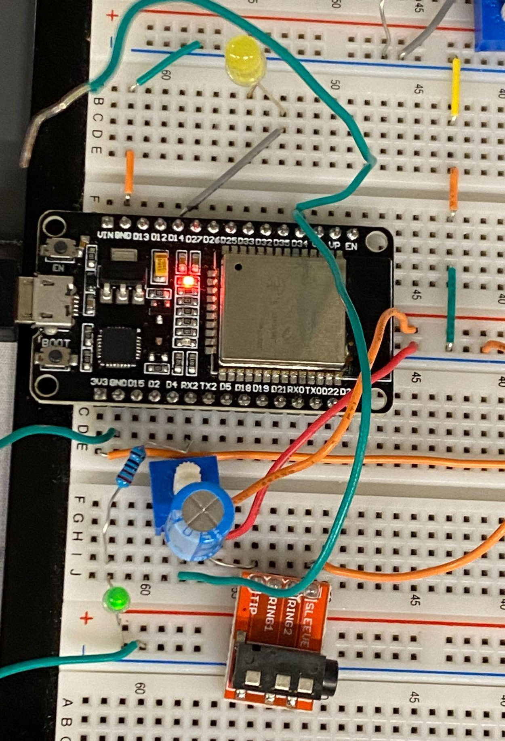
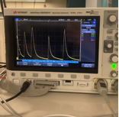
Prototyping Progress
Microphone and AUX prototyping circuit, with oscilloscope readings
Notes:
graeme

Slide 11
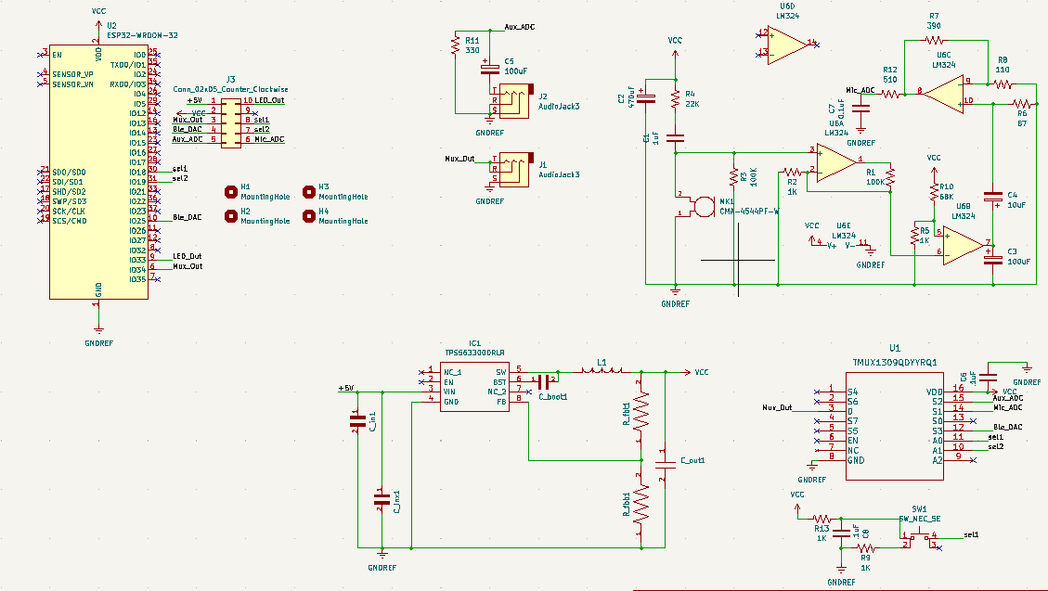
ELECTRICAL SCHEMATIC
Full Schematic

Slide 12
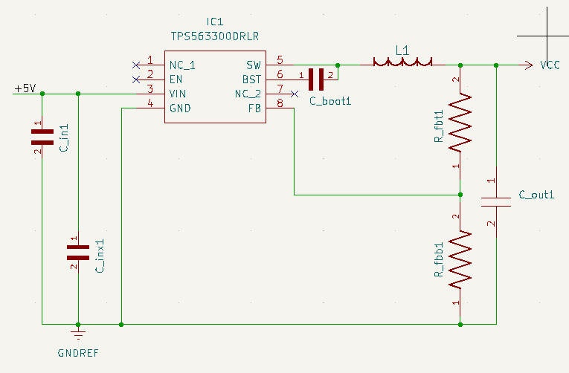
ELECTRICAL SCHEMATIC
Power
Designed using the TI Power WEBENCH
Input Voltage of 5V
Supplies 3.3V @ 0.5A to the MCU

Slide 13
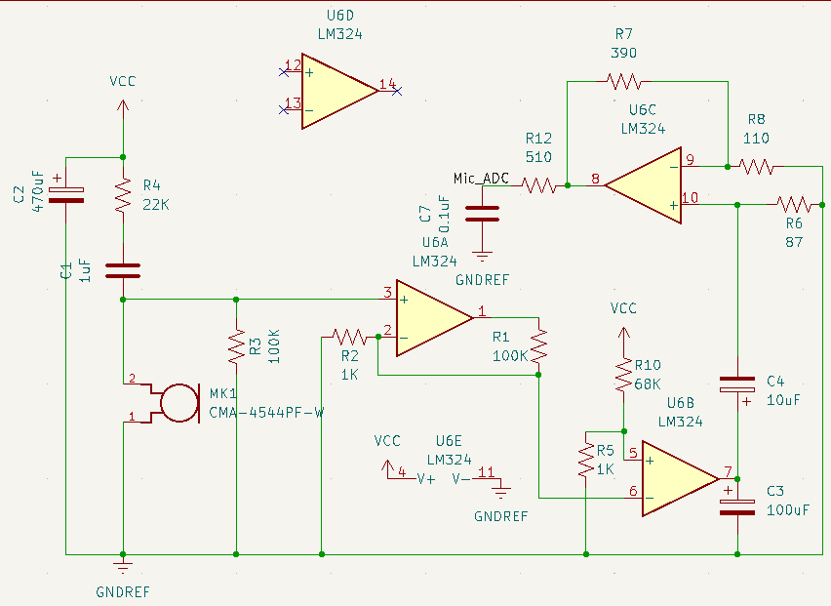
ELECTRICAL SCHEMATIC
Mic Amplifier and Filtering
Non-inverting op amp with a gain of 101x
V_{out} = V_{in}(1+(R₁/R₂))
Low Pass Filter cutoff frequency @ ~3kHz
f_{c}= 1/2πR₁₂C₇
High Pass Filter cutoff frequency @ ~187Hz
f_{c}= 1/2πR₆C₄

Slide 14
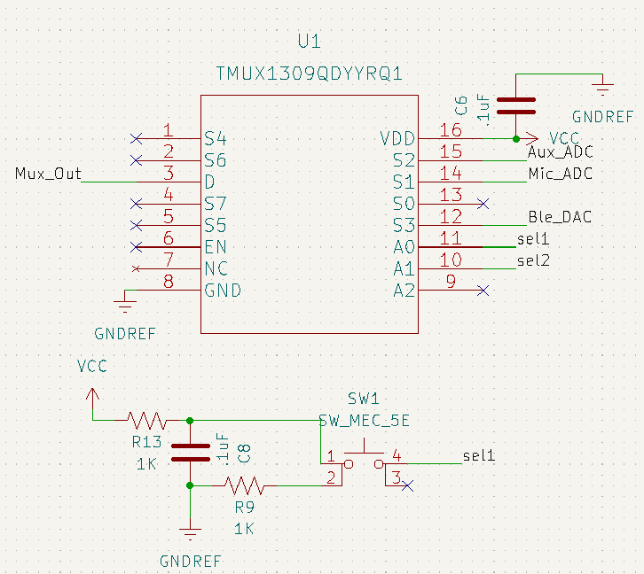
ELECTRICAL SCHEMATIC
Analog Mux
Debouncing done on the mode-switching button
Analog inputs are chosen through select lines controlled by MCU/push button

Slide 15
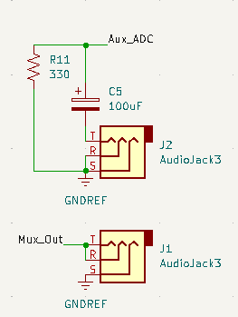
ELECTRICAL SCHEMATIC
Aux Audio

Slide 16
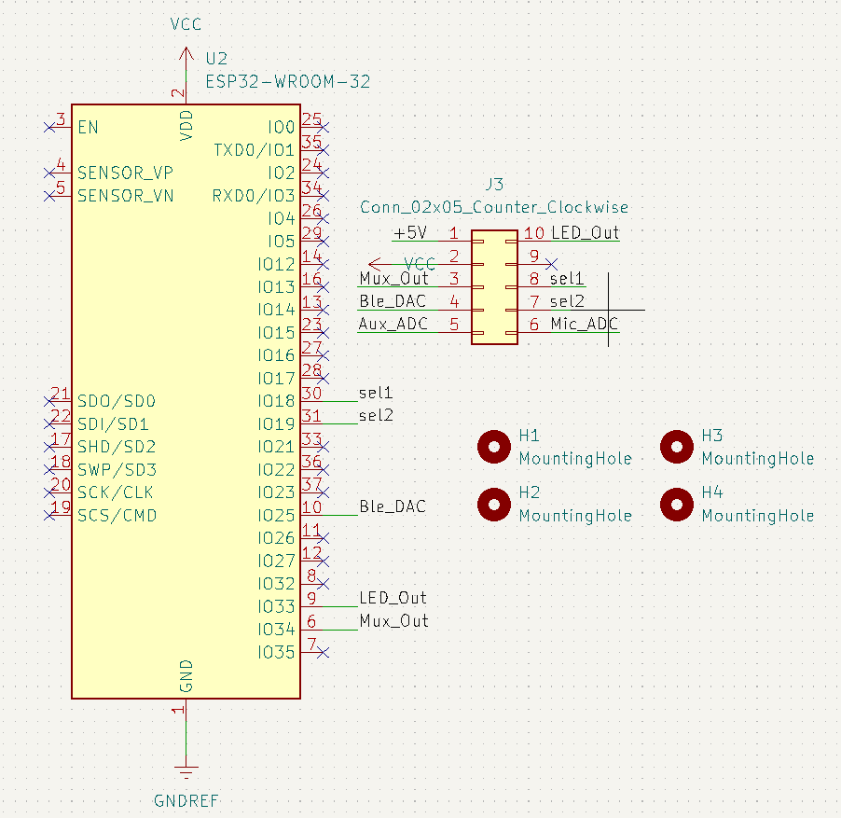
ELECTRICAL SCHEMATIC
Microcontroller

Slide 17
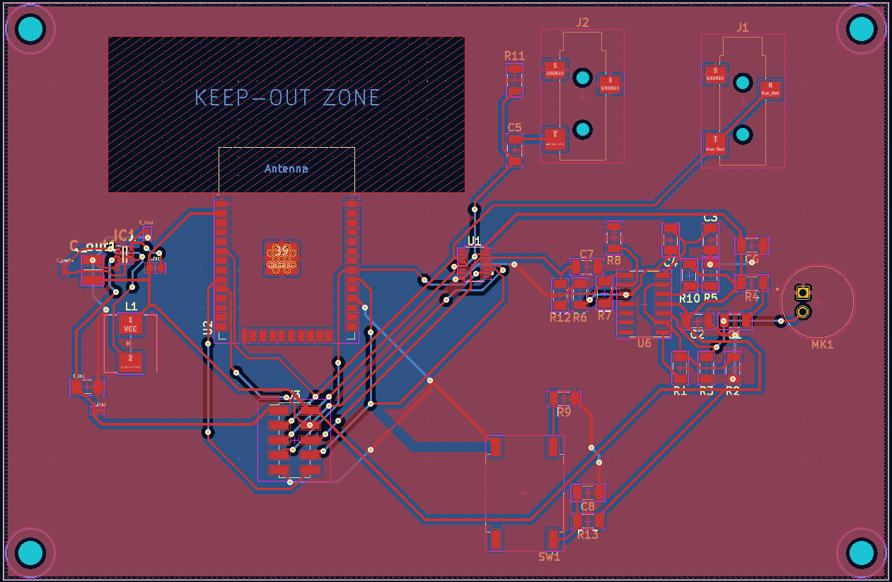
PCB LAYOUT
Full PCB
Notes:
avik

Slide 18
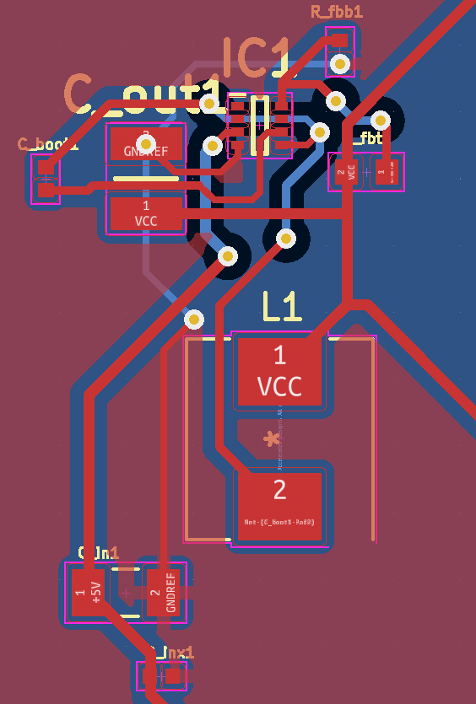
PCB LAYOUT
Power
Notes:
avik

Slide 19
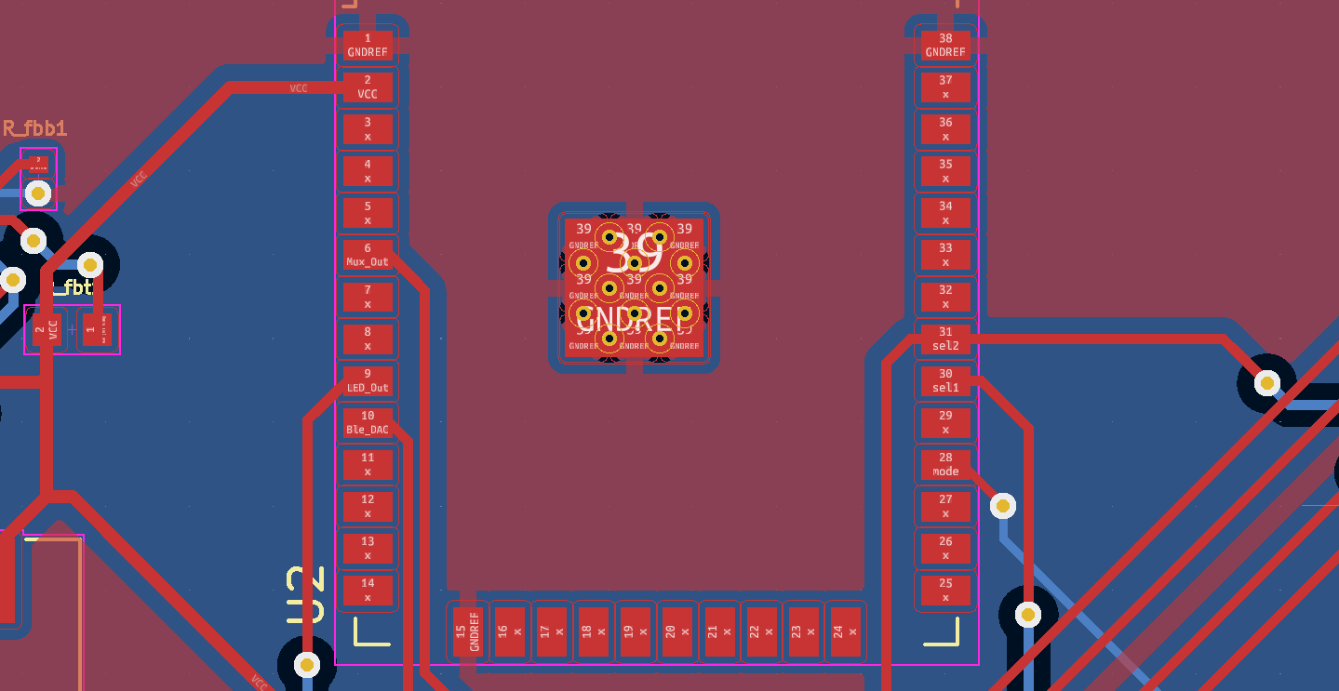
PCB LAYOUT
Microcontroller
Notes:
avik

Slide 20
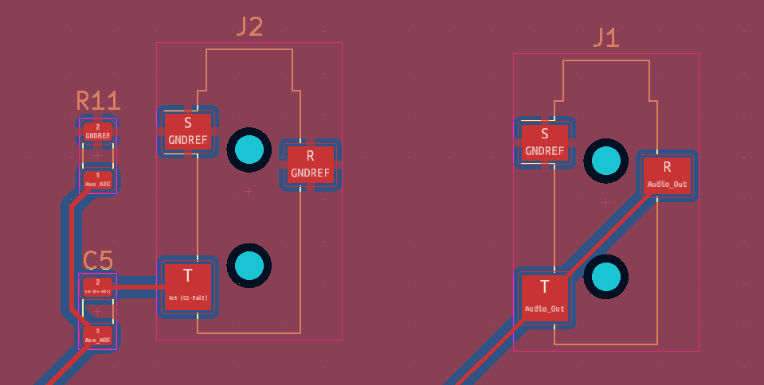
PCB LAYOUT
Aux Jacks
Notes:
avik

Slide 21
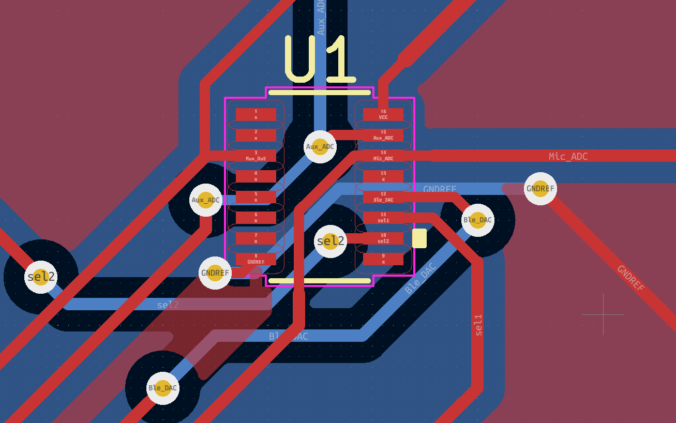
PCB LAYOUT
TMUX
Notes:
avik

Slide 22
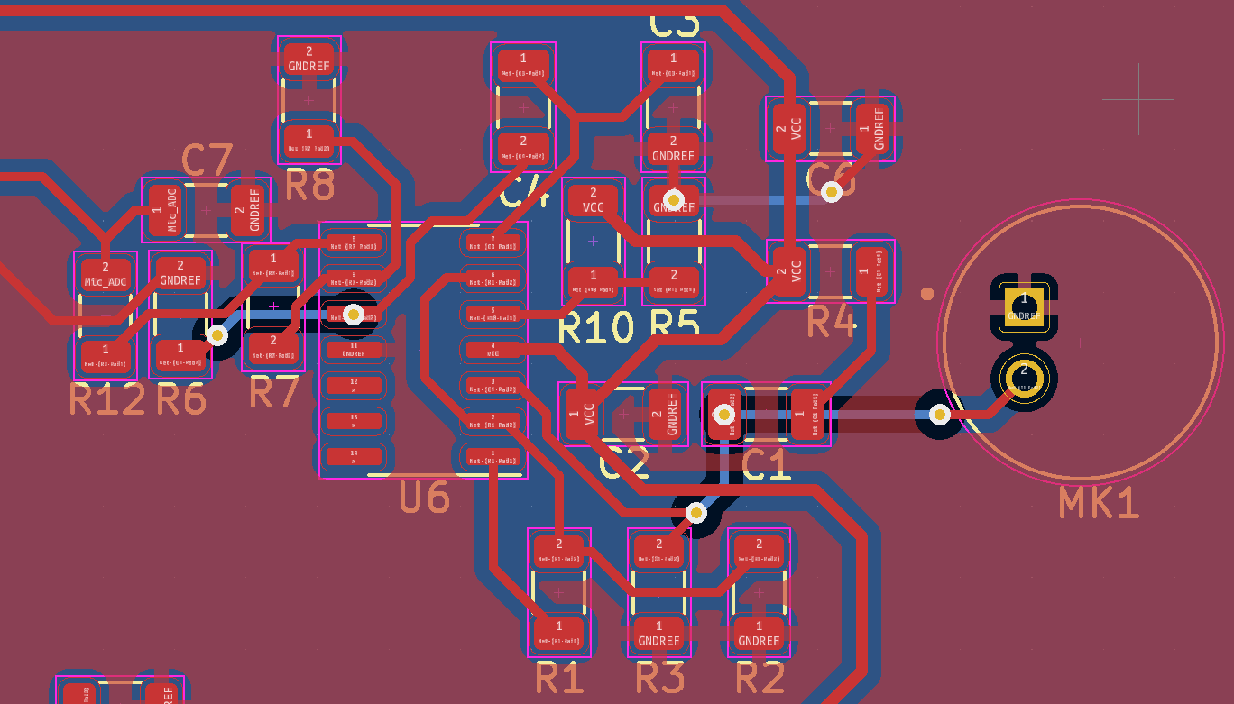
PCB LAYOUT
Mic
Notes:
avik

Slide 23
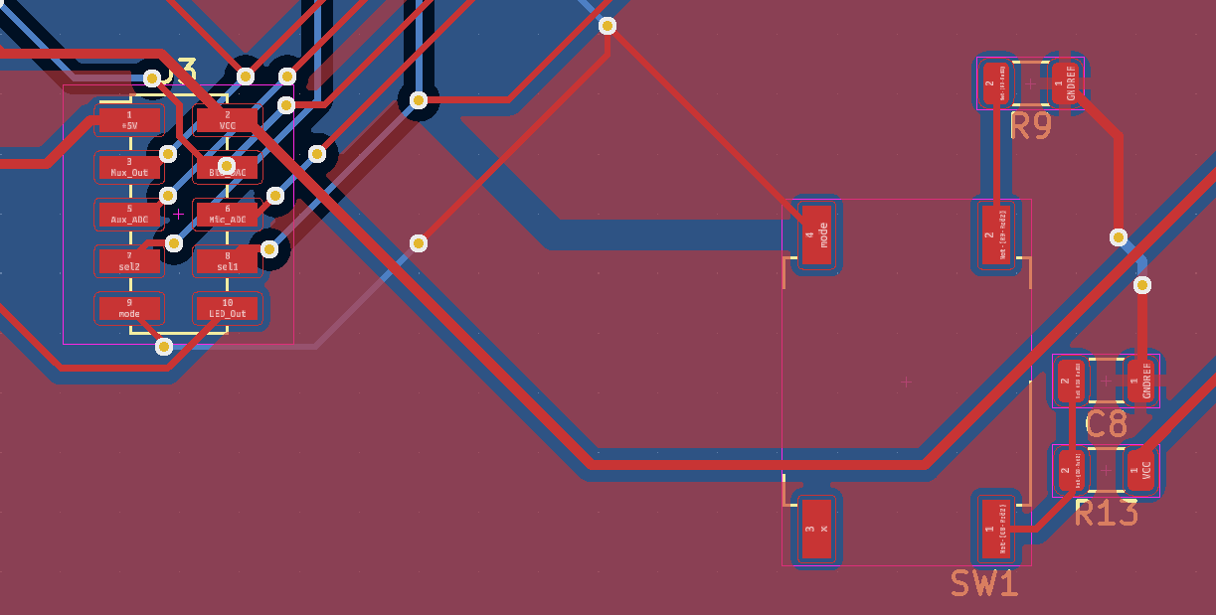
PCB LAYOUT
Debug Port and Mode Switch Button
Notes:
avik

Slide 24
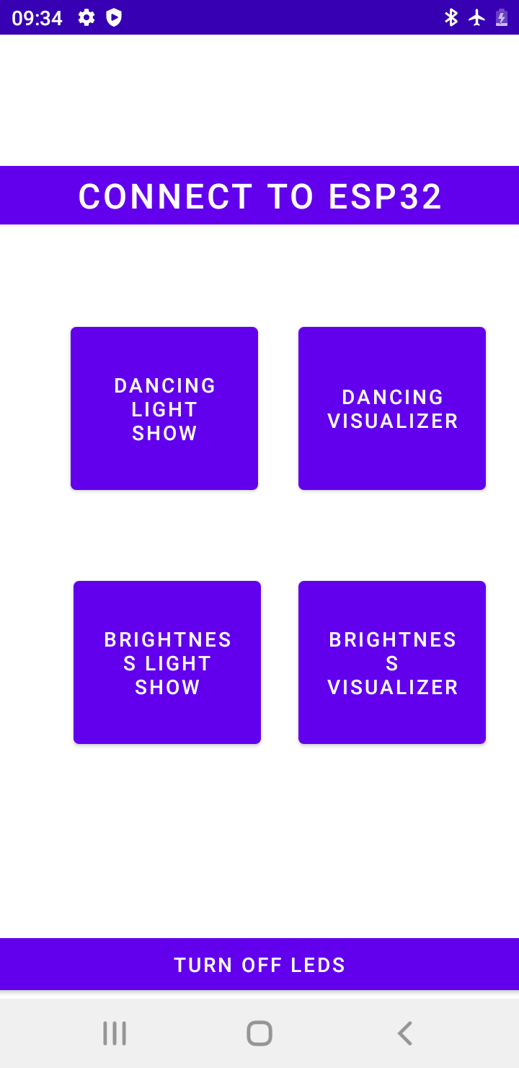
SOFTWARE DEVELOPMENT STATUS
App Development
Connect/Disconnect
Turn On/Turn off Leds
2 Core Features
Dancing
Light Color Control
Preset Menu
Brightness
Light Intensity Control
Preset Menu
Ability to send 16 bit int to parse state.
Notes:
kahaan

Slide 25
SOFTWARE DEVELOPMENT STATUS
Firmware Development
Component | Status
Continuous ADC sampling | 100%
Continuous DAC output | 0%
Gaussian Smoothing | 100%
FFT Algorithm | 80%
LED control | 66%
Input Mode Switching | 0%
Communication with Android App | 10%
Notes:
anu

Slide 26
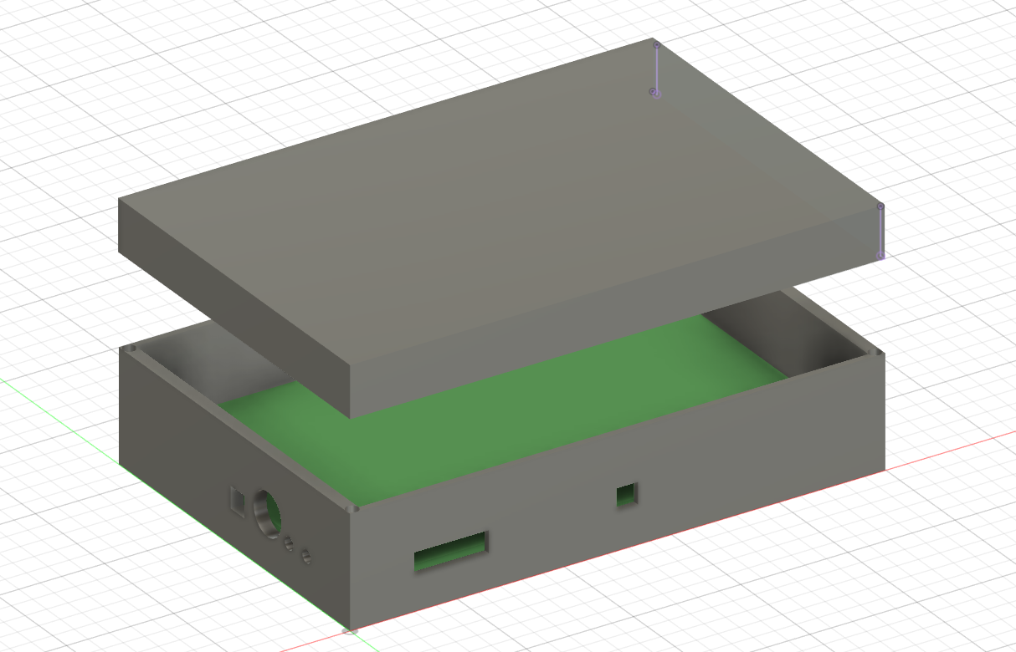
PACKAGING DESIGN
PCB Housing (Open)
Notes:
anu

Slide 27
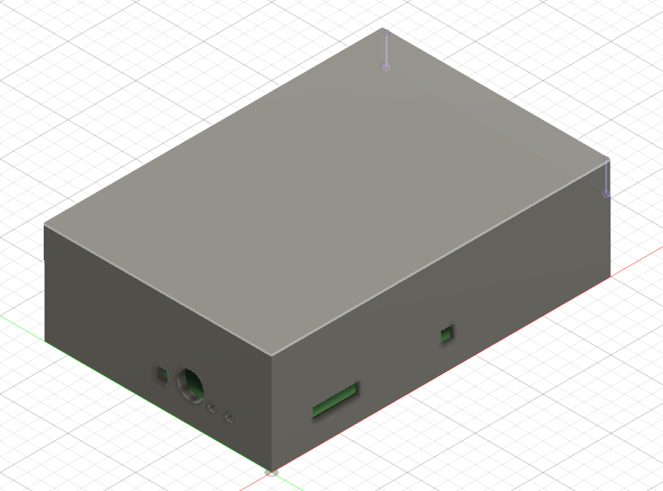
PACKAGING DESIGN
PCB Housing (Closed)
Notes:
anu

Slide 28
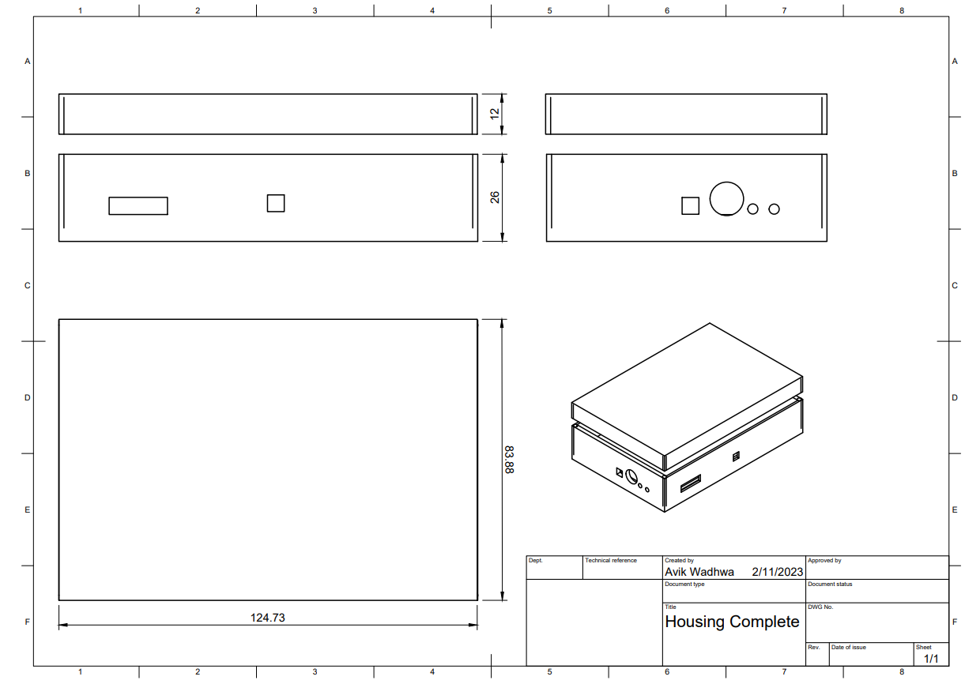
PACKAGING DESIGN
PCB Housing Dimensions
units: mm
Notes:
anu

Slide 29
PACKAGING DESIGN
LED Fixture Dimensions
units: mm
Notes:
anu

Slide 30
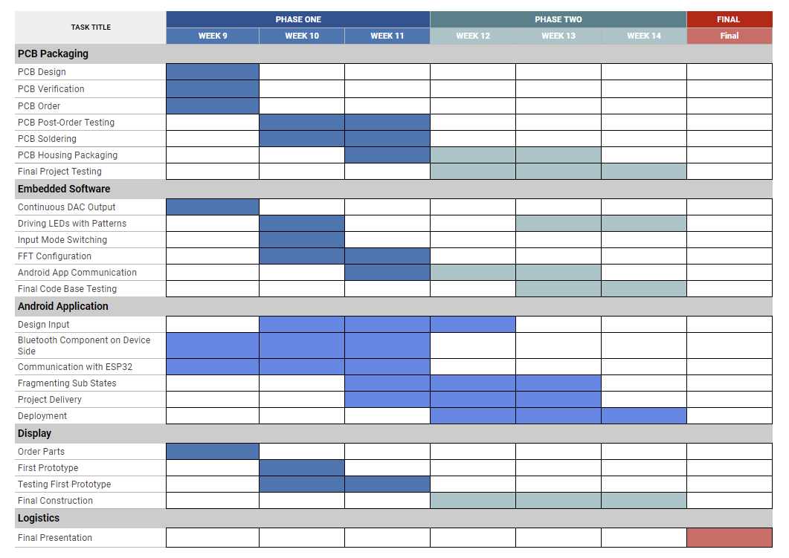
PROJECT TIMELINE
Notes:
anu

Slide 31
3D PRINTING
Questions?

